Slide 1
NJCEP Refresher for NJ Property Owners Association members
October 22, 2020
New Jersey’s Clean Energy ProgramTM
Lighting the way to New Jersey’s Clean Energy Future
Notes:
TITLE SLIDE OPTION B

Slide 2
Webinar Instruction Page
Housekeeping Items
Ask questions using the form in the webinar control panel
Questions can be submitted at any point during the webinar
We will leave a minute or two at the end of the webinar if you would like to submit your questions at that time
You can also send in questions after the webinar using contact info we will provide

Slide 3
NJCEP Background
Administered by
New Jersey Board of Public Utilities’ Division of Clean Energy
Funding
Societal Benefits Charge (SBC) on utility bill
Program Goals
Education
Change behavior
Provide opportunity for ALL NJ residents to
reduce energy and lower operating cost
Protect the environment and lower emissions
Meet Governor’s goal of 100% clean energy by 2050

Slide 4
Programs to Meet Goals
CUSTOMER Education
ENERGY CONSERVATION
ENERGY EFFICIENCY
DISTRIBUTED ENERGY RESOURCES
Renewable energy

Slide 5
Program highlights
Notes:
We will go through how those programs performed in FY18

Slide 6
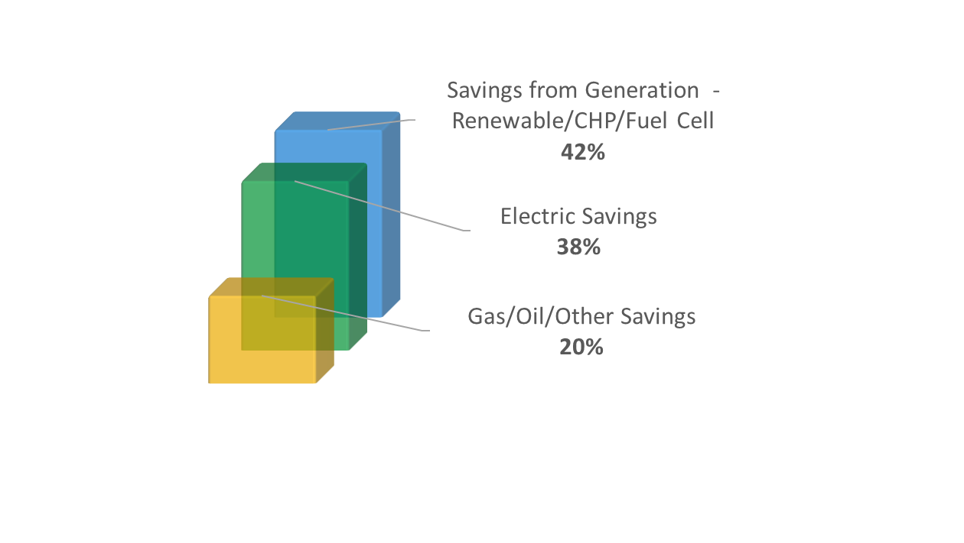
Program Performance…
FY19 data
131,000+ applications processed in FY19
Energy Savings are delivered through electric, gas, oil, other efficiencies and generation
$136,000,000+ incentives paid in FY19

Slide 7
…Brings Real-World Results
FY19 data
Clean Energy Programs eliminated enough CO₂ to equate to:
96,000+ cars removed
7,400,000+ trees planted
452,616 metric tons greenhouse gases eliminated
Notes:
Note
Stats are just FY19 performance of metric tons of CO2 eliminated annually.
Source
https://www.epa.gov/energy/greenhouse-gases-equivalencies-calculator-calculations-and-references

Slide 8
NJCEP Portfolio of Programs
Renewable ENERGY
SPECIALIZED ENERGY EFFICIENCY
COMMERCIAL & INDUSTRIAL
DISTRIBUTED ENERGY RESOURCES
RESIDENTIAL
Offshore Wind
TREC - Solar Registration
Community Solar
Community Energy Grants
State Facility Initiatives
R&D Energy Tech Hub*
Workforce Development*
Energy Audits
Energy Efficiency Incentives
Trade Allies
Combined Heat & Power – Fuel Cells
Microgrid Development
Battery Storage*
Electric Vehicles
New Construction
Existing Homes
Energy Efficient Products
Trade Allies
* coming soon!

Slide 9
C&I Programs

Slide 10
C&I Portfolio of Programs
Eligible Sectors: Commercial, Industrial, Government, Schools, Non-Profit, Institutional and Multifamily
Measurement & AUDITS
COMPREHENSIVE PROGRAMS
SINGLE MEASURE REBATES
DISTRIBUTED ENERGY RESOURCES
Energy Benchmarking
Local Government Energy Audits
Large Energy Users
Pay for Performance
Existing Buildings
New Construction
Direct Install
Customer Tailored Energy Efficiency
SmartStart
Existing Buildings
New Construction
Combined Heat & Power - Fuel Cells
Microgrid Development
Battery Storage*
Electric Vehicles
in a UEZ or OZ
owned or operated by a local government (municipalities and counties)
owned or operated by a K-12 public school
designated as affordable housing
Some programs offer enhanced incentives
to buildings:
* coming soon!

Slide 11
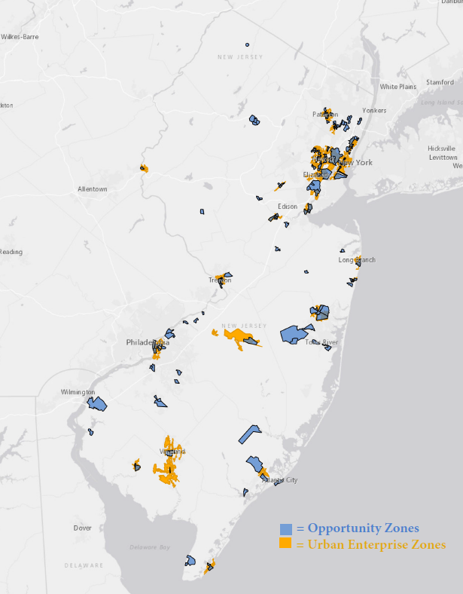
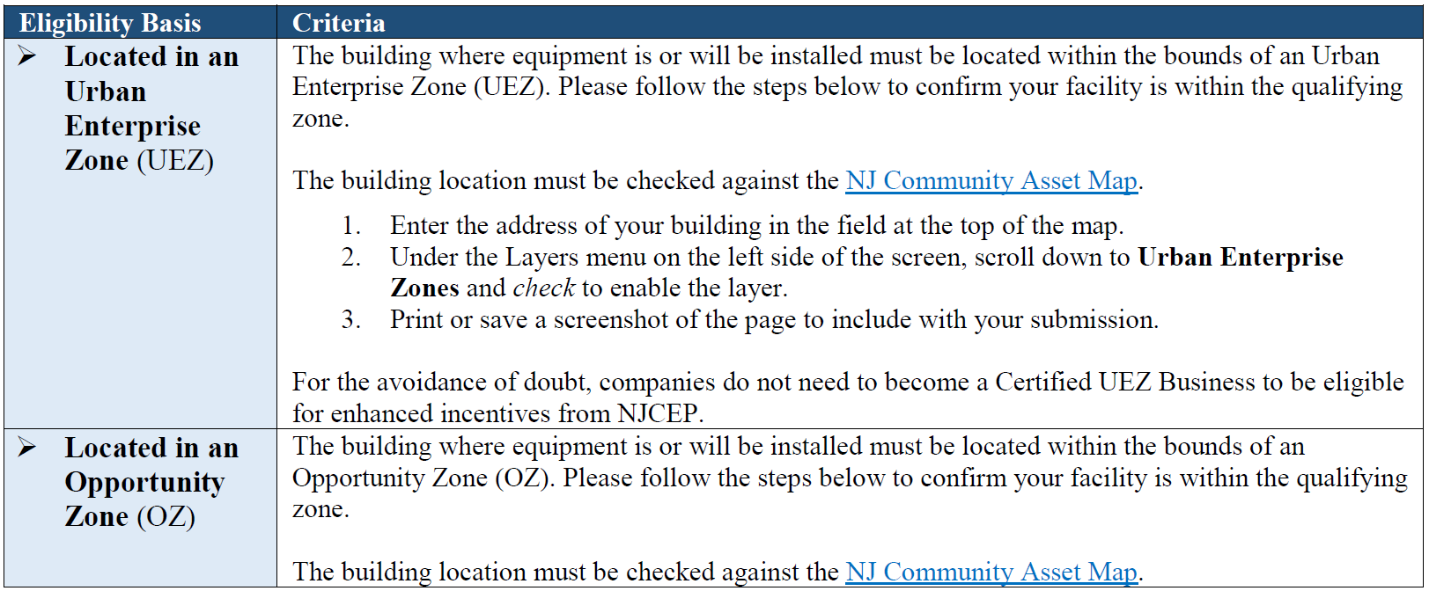
Enhanced Incentives
in a UEZ or OZ
owned or operated by a local government (municipalities and counties)
owned or operated by a K-12 public school
designated as affordable housing
Some programs offer enhanced incentives
to buildings:
Click here for a link to NJ Community Asset Maps

Slide 12
Benchmarking
Measurement & AUDITS
NJCleanEnergy.com/BENCHMARKING
WHO
Commercial, Industrial, Agricultural, Government, 501(c)(3) Non-Profit, and Institutional Entities
Cost
Free
WhY
Compare your building to other similar buildings nationally
Suggestions for improving operations and maintenance
Personalized incentive program eligibility and account manager follow-up support
ENERGY STAR® Portfolio Manager account setup and score
Great opportunity to be a leader in benchmarking energy and water use, prior to the 2024 deadline.

Slide 13
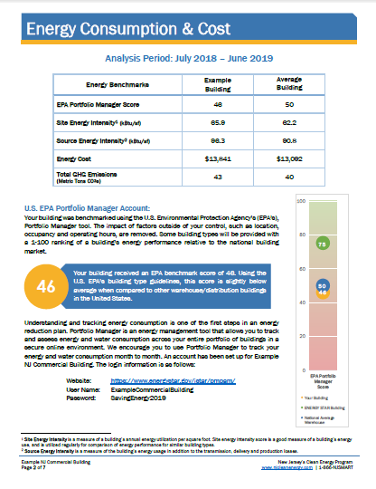
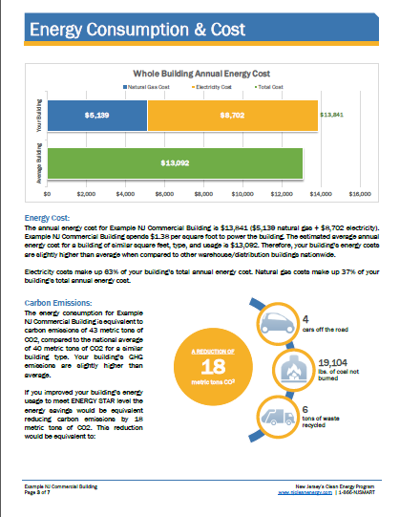
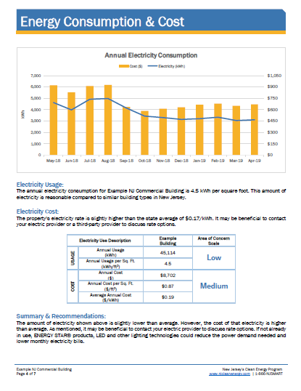
Benchmarking
Measurement & AUDITS
NJCleanEnergy.com/BENCHMARKING

Slide 14
C&I Portfolio of Programs
Eligible Sectors: Commercial, Industrial, Government, Schools, Non-Profit, Institutional and Multifamily
Measurement & AUDITS
COMPREHENSIVE PROGRAMS
SINGLE MEASURE REBATES
DISTRIBUTED ENERGY RESOURCES
Energy Benchmarking
Local Government Energy Audits
Large Energy Users
Pay for Performance
Existing Buildings
New Construction
Direct Install
Customer Tailored Energy Efficiency
SmartStart
Existing Buildings
New Construction
Combined Heat & Power - Fuel Cells
Microgrid Development
Battery Storage*
Electric Vehicles
in a UEZ or OZ
owned or operated by a local government (municipalities and counties)
owned or operated by a K-12 public school
designated as affordable housing
Some programs offer enhanced incentives
to buildings:
* coming soon!
Notes:
Order of programs discussed is from larger to smaller in building size

Slide 15
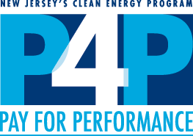
Pay for Performance
Comprehensive
Programs
NJCleanEnergy.com/P4P
WHO
Large C&I existing buildings or new construction seeking two or more energy efficiency measures with a minimum 15% savings
SIZE TO QUALIFY
Annual peak demand 200+ kW in the previous year for existing buildings or over 50,000 square feet of planned new construction
ABOUT
A pre-approved Participating Partner will streamline the program and guide users through the program phases
Incentive CAP
50% of project cost (or 80% for eligible enhanced incentive* projects) up to $2M per project / $4M per entity annually
Incentive payments #2 and #3 are increased for eligible enhanced incentive* projects
* Enhanced incentives are available to existing buildings in a UEZ/OZ, K-12 public school, local governments (municipalities and counties), or designated as affordable housing

Slide 16
Pay for Performance
Comprehensive
Programs
NJCleanEnergy.com/P4P
1 year
Program Enrollment
Submission and Approval of Application
Energy Reduction Plan (ERP)
Development and Approval
Installation of Measures
Installation Verification Report
Verification of Savings
Comparison of Performance vs ERP
Incentive #1
fixed
Incentive #2
up to 25%
project cost
Incentive #3
up to 25%
project cost
Incentive #2
up to 40%
project cost
Enhanced incentives* to eligible existing buildings
Incentive #3
up to 40%
project cost
* Enhanced incentives are available to existing buildings in a UEZ/OZ, K-12 public school, local governments (municipalities and counties), or designated as affordable housing
Notes:
2-3 years to complete the process (plan for 3 years)
Installation Verification Report:
NC: As-Built ERP
EB: Installation Report

Slide 17
Direct Install
Comprehensive
Programs
NJCleanEnergy.com/DI
WHO
Small to medium sized C&I existing facilities seeking to replace inefficient equipment
SIZE TO QUALIFY
Average annual peak demand <200 kW in the previous 12 months
ABOUT
A pre-approved regional Participating Contractor will do a walk-through evaluation and guide users through the program phases
Turn-key process with fast project turnaround time
INCENTIVE CAP
$125,000 incentive funding per project/building ($250k for eligible enhanced incentive* projects), or
$250,000 per entity ($500K ESIP; $4M for eligible enhanced incentive* entities)
* Enhanced incentives are available to existing buildings in a UEZ/OZ, K-12 public schools, local governments (municipalities and counties), or designated as affordable housing

Slide 18
Direct Install
Comprehensive
Programs
NJCleanEnergy.com/DI
Facilities in Urban Enterprise Zones (UEZ), Opportunity Zones (OZ), local government (municipalities and counties), K-12 public school, or designated as affordable housing:
INCENTIVE FUNDING
Up to 80% of installed cost is paid directly to the contractor
CUSTOMER
20% of installed cost
All other eligible facilities:
INCENTIVE FUNDING
Up to 70% of installed cost is paid directly to the contractor
CUSTOMER
30% of installed cost

Slide 19
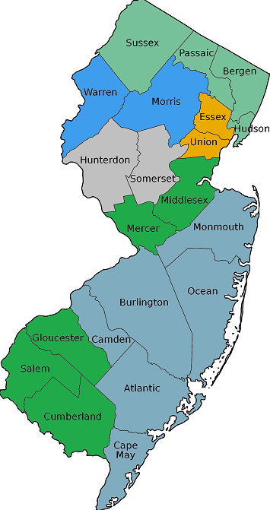
Direct Install
Comprehensive
Programs
NJCleanEnergy.com/DI
Lime Energy
Chris Fornicola
732-427-7278
chris.fornicola@lime-energy.com
Donnelly Energy Justin Avallone 845-401-6253 javallone@donnellyenergy.com
Willdan Energy Solutions David Torres 732-662-4228 x6120 david.torres@willdan.com
CMC Energy Services, Inc. Ben Altomari 888-331-5891 baltomari@cmcenergy.com
Hutchinson Mechanical Services Pete Hatton 856-429-5828 x259 petehatton@hutchbiz.com
Tri-State Light & Energy, Inc. Alan Rhode 610-789-1900 x226 asr@tsle.com

Slide 20
Direct Install: Be a Contractor
Comprehensive
Programs
NJCleanEnergy.com/DI
If an applicant wishes to utilize their own pre-existing contractor*, rather than the pre-selected regional contractor for their county, the C&I Program Manager will work with the applicant's contractor to confirm that the contractor:
Meets all of the program's bid requirements
Agrees to the program's set pricing
Participates in program training provided by the Program Manager
Signs the Direct Install Program Sub-Contractor Agreement
A contractor participating in the program through this path will be allowed to submit a project or projects up to a $125,000 maximum in contractor allocation per fiscal year
More information can be found at https://www.njcleanenergy.com/misc/commercial-industrial/direct-install-process-contractor-participation
* Pre-existing relationship is defined as having performed an energy efficiency upgrade in one or more of the applicant's facilities within the past 24-month period.

Slide 21
CTEEP: Customer Tailored
Energy Efficiency
Comprehensive
Programs
NJCleanEnergy.com/CTEEP
WHO
C&I customers seeking a streamlined/single application for participants submitting for multiple different technology types
SIZE TO QUALIFY
N/A
ABOUT
On site assistance available
One application form for multiple prescriptive or custom measures
Utilizes SmartStart Incentives
Additional $10,000 technical incentive available to offset soft costs associated with developing and planning custom projects
INCENTIVE CAP
Up to $500,000 for each electric or gas account
Same Prescriptive or Custom incentives as the SmartStart Buildings program

Slide 22
CTEEP: Customer Tailored
Energy Efficiency
Comprehensive
Programs
NJCleanEnergy.com/CTEEP
Scoping Session
One-on-One customization with program staff
Energy Efficiency Plan
Application Approval
Installation of Measures
Confirmation of Installation
Incentives* Paid
Same incentive values as SmartStart
* Enhanced incentives are available to existing buildings in a UEZ/OZ, K-12 public school, local governments (municipalities and counties), or designated as affordable housing

Slide 23
C&I Portfolio of Programs
Eligible Sectors: Commercial, Industrial, Government, Schools, Non-Profit, Institutional and Multifamily
MEASUREMENT & AUDITS
COMPREHENSIVE PROGRAMS
SINGLE MEASURE REBATES
DISTRIBUTED ENERGY RESOURCES
Energy Benchmarking
Local Government Energy Audits
Large Energy Users
Pay for Performance
Existing Buildings
New Construction
Direct Install
Customer Tailored Energy Efficiency
SmartStart
Existing Buildings
New Construction
Combined Heat & Power - Fuel Cells
Microgrid Development
Battery Storage*
Electric Vehicles
in a UEZ or OZ
owned or operated by a local government (municipalities and counties)
owned or operated by a K-12 public school
designated as affordable housing
Some programs offer enhanced incentives
to buildings:
* coming soon!

Slide 24
SmartStart
SINGLE MEASURE
rebates
NJCleanEnergy.com/SSB
WHO
All C&I: commercial, industrial, agricultural, government, non-profit institutional, and multifamily customers
SIZE TO QUALIFY
N/A
ABOUT
Individual high efficiency equipment rebates for new construction, renovation, remodeling, equipment replacement
Prescriptive and custom designed measures
INCENTIVE CAP
Prescriptive: $500,000 for each electric or gas account
Custom, lesser of the following:
$0.16/kWh and/or $1.60/therm saved annually;
50% of incremental installed cost; and
Buy-down to 1 year payback based on incremental cost and savings

Slide 25
SmartStart
SINGLE MEASURE
rebates
NJCleanEnergy.com/SSB
Prescriptive Incentives
Custom Incentives
Electric Chillers
Gas Cooling
Electric Unitary HVAC
Ground Source Heat Pumps
Gas Heating
Variable Frequency Drives
Gas Water Heating
Lighting/Lighting Controls
Refrigeration Doors
Refrigeration Controls
Food Service Equipment
Refrigerator/Freezer Motors
New or innovative technologies proven to be cost-effective and not listed as prescriptive
Must meet code for retrofit projects or exceed code for new construction
Project pre and post inspection required
Existing buildings only:
Double incentives for OZ/UEZ, local government (munis & counties), K-12 public school, or designated as affordable housing
Notes:
New in FY21:
Indoor horticultural lighting is prescriptive
Enhanced incentives applicable to Custom

Slide 26
C&I Portfolio of Programs
Eligible Sectors: Commercial, Industrial, Government, Schools, Non-Profit, Institutional and Multifamily
MEASUREMENT & AUDITS
COMPREHENSIVE PROGRAMS
SINGLE MEASURE REBATES
DISTRIBUTED ENERGY RESOURCES
Energy Benchmarking
Local Government Energy Audits
Large Energy Users
Pay for Performance
Existing Buildings
New Construction
Direct Install
Customer Tailored Energy Efficiency
SmartStart
Existing Buildings
New Construction
Combined Heat & Power - Fuel Cells
Microgrid Development
Battery Storage*
Electric Vehicles
in a UEZ or OZ
owned or operated by a local government (municipalities and counties)
owned or operated by a K-12 public school
designated as affordable housing
Some programs offer enhanced incentives
to buildings:
* coming soon!

Slide 27
Combined Heat & Power - Fuel Cells
distributed
energy
NJCleanEnergy.com/CHP
WHO
C&I customers that require on-site electric generation that either does or does not utilize waste heat
SIZE TO QUALIFY
N/A - Projects must pass a cost-effectiveness test and run 5,000 full load equivalent hours per year (3,500 for critical facilities)
ABOUT
Combined Heat & Power (CHP) units generates electricity and recycle waste heat to provide heating or cooling
Resiliency with return on investment
Technology-neutral incentives
Fuel Cells (FC) with or without heat recovery (HR)
INCENTIVE
Levels
CHPs and FC with HR have a project cap of $2M - $3M
25% bonus for critical facilities with black-start/islanding capabilities
Up to 30% incentive bonus for CHP using biofuel
FC without HR have a project cap of $1M

Slide 28
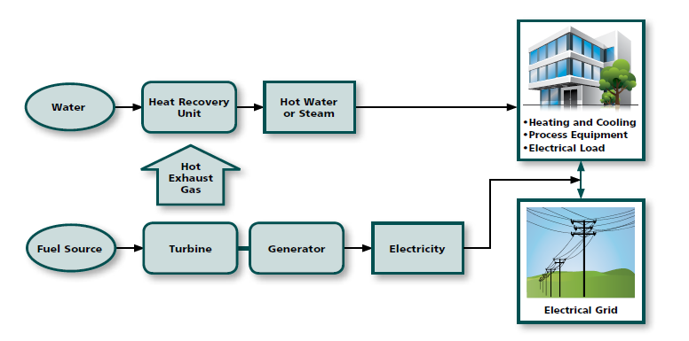
Combined Heat & Power
distributed
energy
NJCleanEnergy.com/CHP

Slide 29
RESIDENTIAL PROGRAMS

Slide 30
Residential Portfolio of Programs
NJCleanEnergy.com/RESIDENTIAL
Home Performance w/ ENERGY STAR®
WARMAdvantage & COOLAdvantage
Energy Efficient Product Rebates
Residential New Construction
Comfort Partners
Whole-house and safety solutions for existing homes
Air sealing, insulation, heating and cooling upgrades
Up to a $4,000 rebate + 0% financing up to $10,000 or .99% up to $15,000
Stand-alone rebates for heating and cooling systems
Furnaces, boilers, water heaters, central air conditioners, mini-splits, heat pumps, etc.
Includes ENERGY STAR® certified refrigerators, dryers, washers, air purifiers, dehumidifiers, room air conditioners
Refrigerator/ freezer recycling and lighting discounts
Builders work with a rater to properly certify the homes to ENERGY STAR® certified or Zero Energy Ready Home levels
A FREE program including lighting upgrades, hot water conservation, replacement of fridges and thermostats, insulation upgrades and heating and cooling maintenance for income eligible families
Some programs offer enhanced incentives for homes located in an UEZ, low to moderate income and affordable housing units

Slide 31
More Information
Tony O’DOnnell
Outreach Account Manager
AODonnell@NJCleanEnergy.com
732.259.4938
Visit
NJCleanEnergy.com
Newsletter
NJCleanEnergy.com/NEWSLETTER
ListservS
NJCleanEnergy.com/LISTSERVS
@NJCleanEnergy
Become a
Trade Ally:
NJCleanEnergy.com/SIGNUP
Notes:
[use this slide or the previous slide]
BPU is welcome to use Outreach@NJCleanEnergy.com

